Slide 1

ENGG404 Lecture Chapter 7.1: The Importance of Leadership: The Links Between Incident Performance, Culture, and the Role of Leadership in Shaping Culture
Fundamentals of RM
RM System and Process
Leadership in RM
Incident Investigation
RM Tools & Challenges
RM in Industry
People & Org.
Application and Perspectives
On becoming a leader in Risk Management

Slide 2
Learning Outcomes:
Explain and demonstrate how leaders can improve safety performance.
Explain the concept of mining the diamond
Explain three ways a good leader can proactively prevent incidents
Chapter 7.1: Importance of Leadership and Links
2
Notes:
Who can tell me in their own words what culture means to you?
How we act around others is a manifestation of your beliefs and attitudes
2

Slide 3
How Can Leaders Shape Safety Culture?
Five key factors for sound leadership in risk management:
Management belief that “safety is a value”.
Management sets clear expectations.
Management is fully committed and is seen to be committed i.e. management is visible.
Management’s actions are always consistent with words.
Management views this as a proactive, long-term undertaking that requires constant attention.
So how do leader put these factors into practice?
Chapter 7.1: Importance of Leadership and Links
3
Notes:
3

Slide 4
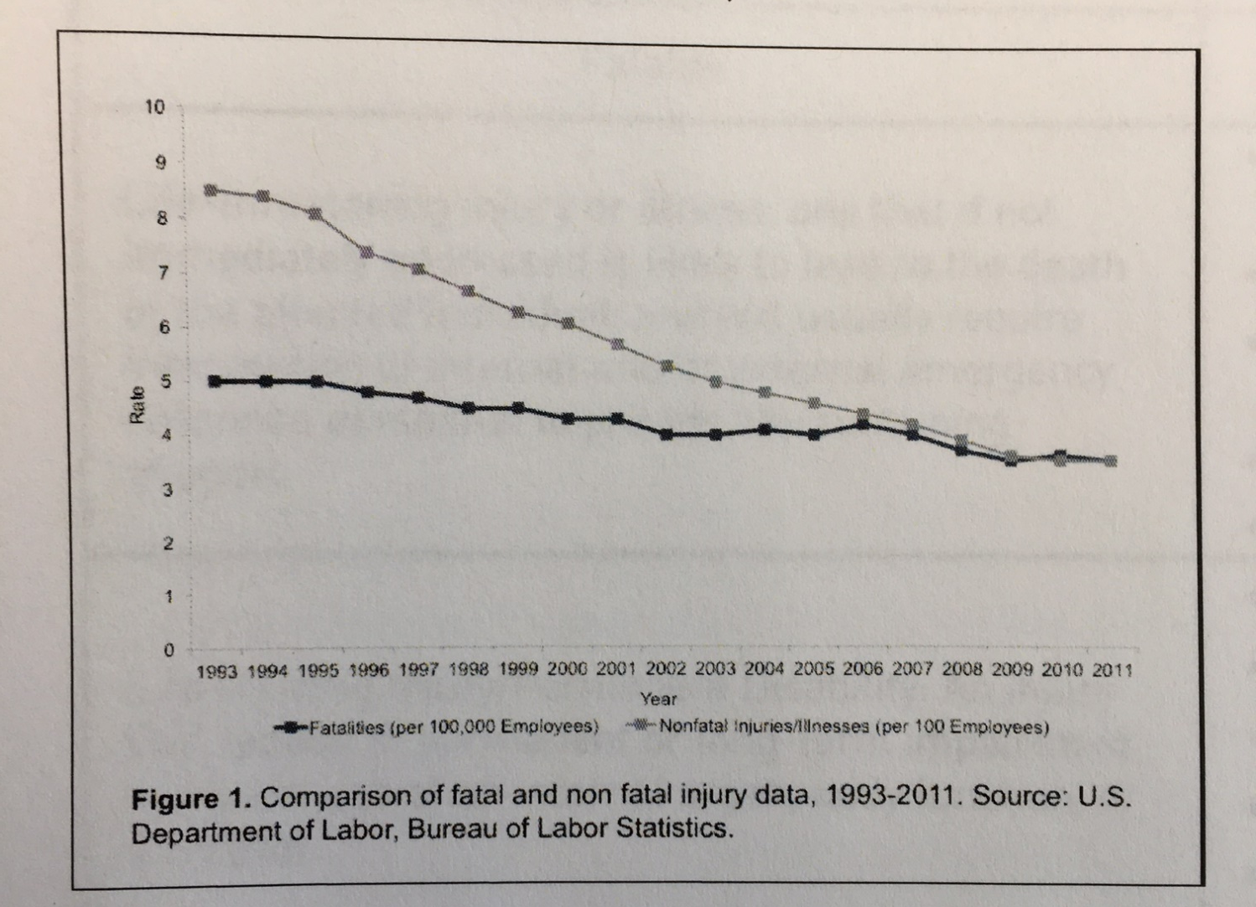
WHY DO INCIDENTS PERSIST?
Injuries
Fatalities
What is the difference between the trend lines? Why?

Slide 5
Classic safety triangle
Fatality
Lost Time
Restricted Duty
Medical Aid
First Aid/Near Miss
Incorrect Assumptions
As injuries increase in severity there is a decrease in frequency
All low severity injuries have the same potential for serious injury
Injuries of differing severity have the same underlying root causes
Reducing less serious injuries will also reduce more serious injuries
Heinrich Safety Triangle

Slide 6
A new paradigm – hi potential (HiPo) incidents
Within the layer, each star represents a lost time incident
(actual outcome)
Fatality
Lost Time
Restricted Duty
Medical Aid
First Aid/Near Miss
Identify a sub-set of incidents (grey area) that, if not for luck, had the potential for a more severe outcome (fatality)
HiPo incidents

Slide 7
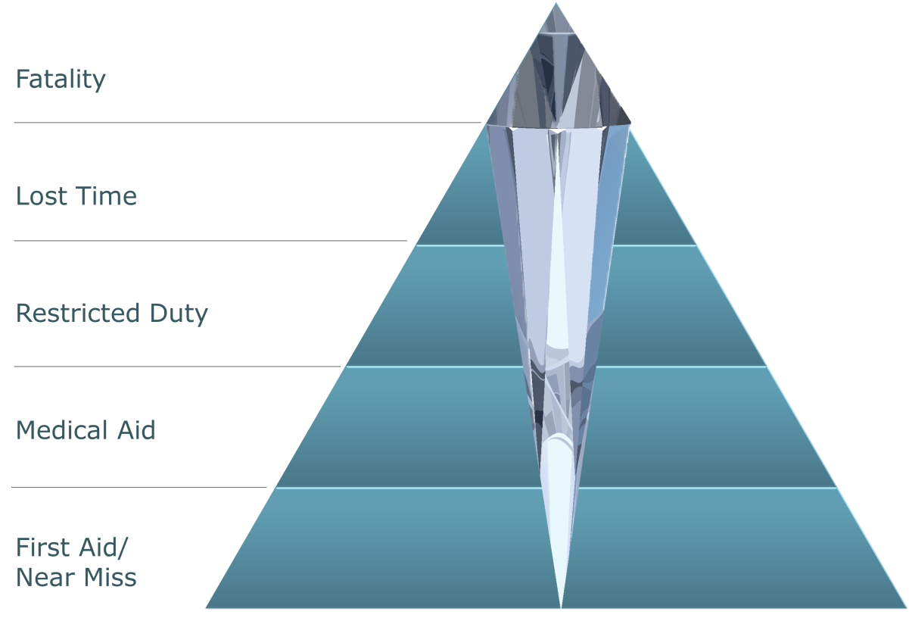
A diamond within the triangle
By examining each layer in the incident triangle for potential serious incidents/fatalities, we develop the diamond within the triangle.
Common Diamond incident characteristics:
Unusual and non-routine work
Sources of high energy are present
Construction
(Sub) Contractors
Prioritize the incidents with the highest potential for severe consequences

Slide 8
In-Class Exercise: Sub-standard Conditions and Practices:
Consider that there a difference between some kinds of sub-standard practices & conditions and other kinds.
Consider these comparative situations:
Walking by an oil spill on floor vs. walking by someone who is working in an excavation with no shoring
Not wearing eye protection walking through the plant vs. not wearing fall protection when at elevation.
Please confer on the following:
For the “oil spill vs. excavation shoring”, which one you would address first? Why?
For the “no eye protection vs. no fall protection”, which one you would address first? Why?
Chapter 7.1: Importance of Leadership and Links
8
Notes:
8

Slide 9
EXCAVATION ACTIVITIES
Exposure
Energized Lines
Buried utilities
Collapse/Engulfment
Flooding
Man/Machine Interface
Access/Egress
Operator Error
Barriers/Protection
Excavation
Working at Heights
Transport
Haulage
Energy Isolation
Confined Space
Lifting/Rigging
Mitigation
First Call
As built/red line mark ups
Contractor Excavation procedures
Inspections
Risk Assessments
JSA and Pre Task Planning
Training

Slide 10
WORKING AT HEIGHTS
Exposure
Improper Scaffolding
PPE—Tie off, lanyards and harnesses
Falls
Dropped Objects
Housekeeping at Heights
Yellow Tag issues
Access/Egress
Man/Machine Interface
Barriers/Protection
Equipment failure
Excavation
Working at Heights
Transport
Haulage
Energy Isolation
Confined Space
Lifting/Rigging
Mitigation
Working at Heights program
Contractor WAH procedures
Inspections
Training
Risk Assessments
JSA and pretask Planning

Slide 11
Summary and Key Lesson:
“Actions Speak Louder than Words”:
Leaders set expectations through communication and action (e.g. the “Tone at the Top”)
Actions and behaviors are the strongest form of messaging
Three things can leaders do to improve culture, and thereby improve safety performance:
Participate in incident investigations and follow up
Review SC/SP/nearmiss/incident reports (looking for HiPo incidents)
Perform job inspections and audits
Chapter 7.1: Importance of Leadership and Links
11
Notes:
11

